Slide 1
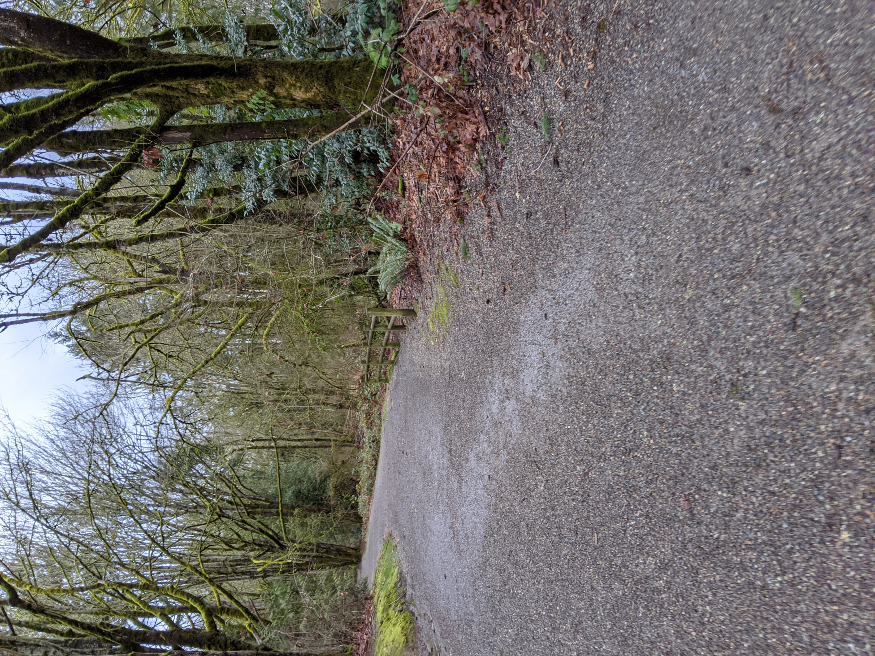
Lake to Lake Trail Analysis
MARCH 2020
CEP Planning Studio - Winter Quarter
Matthew Bauman, Evan Eggerud, Cameron Miller, Sophia Smith

Slide 2
What is “Place”? What is the Lake to Lake trail as a place?
A trail can be more than a thing - it can be a place.
Notes:
A unique combination of universals that give a space its own meaning.

Slide 3
Connectivity
Timeless
Meditative
Art and History
Journey
MEDITATIVE
TIMELESS
Offer places to linger
Restorative
From Gehl Institute
Connections to self, connections to nature
From psychological research
Coordinated Stories
From historical research
Creative and Inclusive Signage
Exploration
From Grand Connection
All-weather and all-day access
From leisure research
Commuting and Bike Routes
From Ped/Bike Plan
Interaction with other infrastructure
Design extending beyond trail itself
Checkpoints
Provides sense of progression
Crossroads
Confluence between infrastructure and places
Assist in wayfinding
Preserve adjacent environment
Withstand climate and change
Balancing nature and built environment
From psychological research
From Utility’s Open Streams drainage systems
ART & HISTORY
Our Vision
Guiding principles for the L2L
JOURNEY
CONNECTIVITY

Slide 4
Public Space Map
CONNECTIVITY
Notes:
Still part of “Connectivity” value

Slide 5
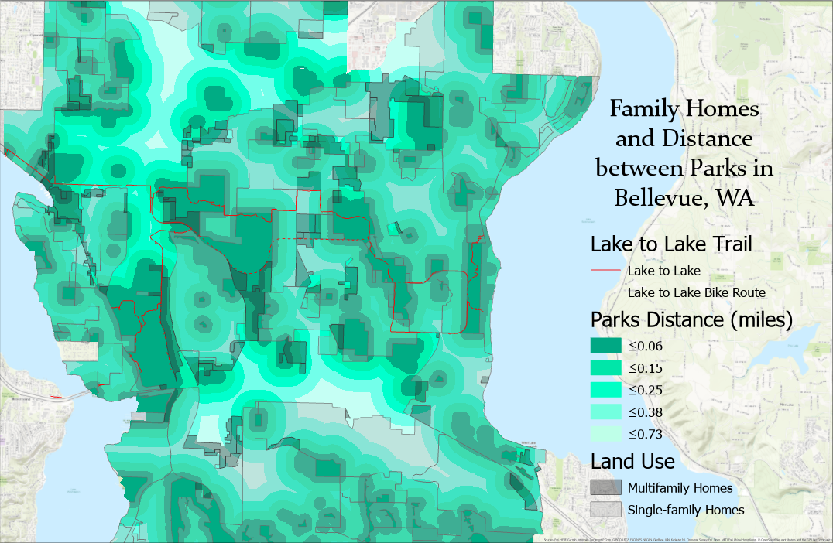
Notes:
Going to office hours to ask more about how to calculate walking times

Slide 6
Field Research
Our experience and analysis of neighborhoods touching the trail
West Bellevue
Wilburton
Lake Hills
West Sammamish
Notes:
Introduce use of Gehl Institute tools, introduce how “random idea” is meant to exemplify value, individual design less important

Slide 7
West Bellevue

Slide 8
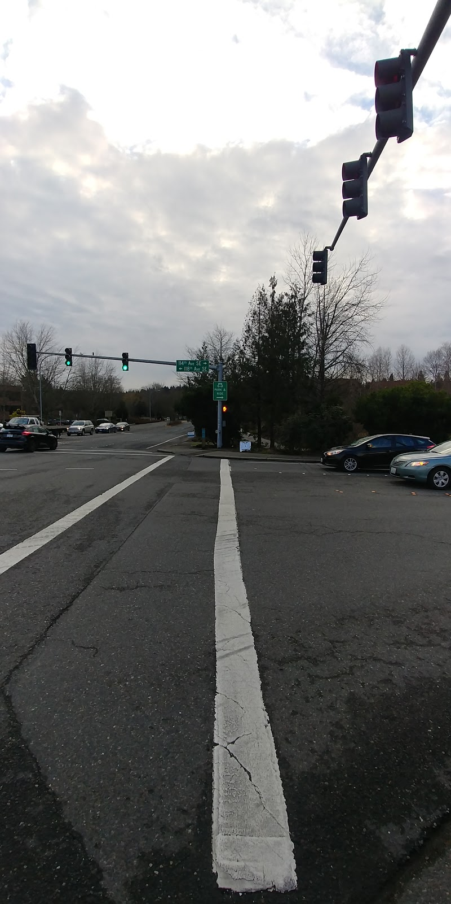
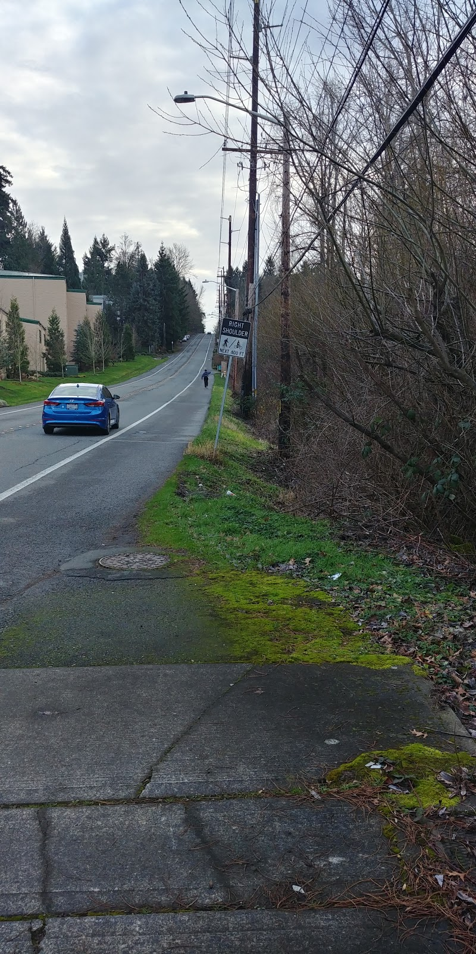
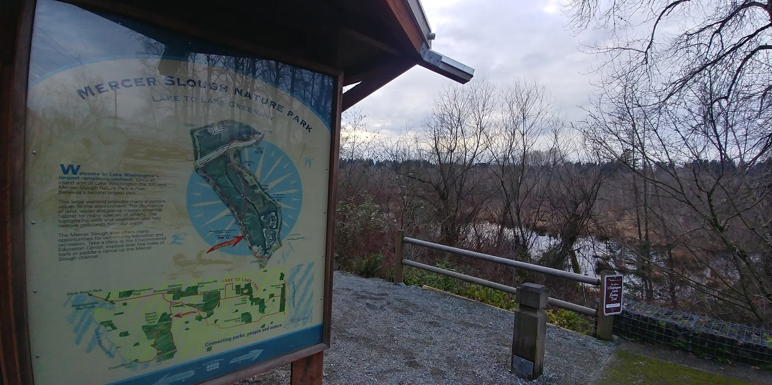
West Bellevue Trail Character
NEIGHBORHOOD ANALYSIS
Sidewalks on 118th
Lots of Crossings
Clear, Pristine Maps

Slide 9
Recommendations for West Bellevue
NEIGHBORHOOD ANALYSIS
Improve and add sidewalks, especially on 118th
Improve crossings around large freeway intersections for a more welcoming pedestrian environment
Improve detour signage and frequency of posting
Utilize the South Bellevue Link Light Rail Station during off-peak times
Create more imaginative signage, welcoming pedestrians, especially where the trail meets the South Bellevue Station

Slide 10
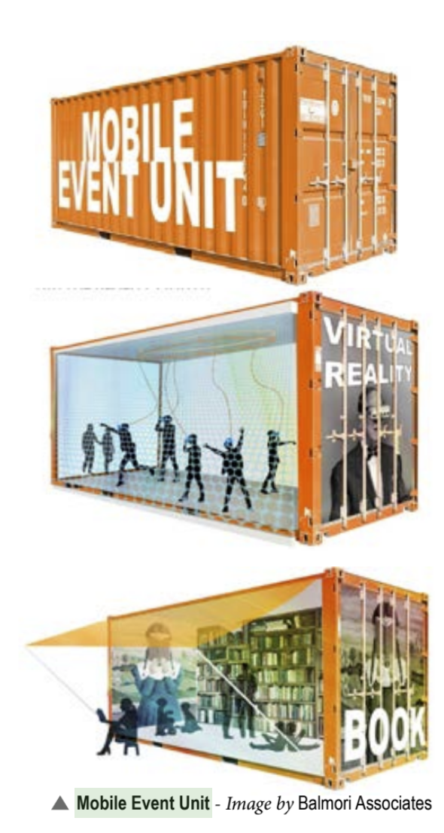
Gatherings in West Bellevue
NEIGHBORHOOD ANALYSIS
CONNECTIVITY
South Bellevue Link Station has open space during off-peak parking times
"Pop-up" events during the evenings and on weekends
Familiarity with the new station/reaching the station
"Mobile Event Units" keep the space's schedule fresh
https://seattletransitblog.com/2013/11/04/planning-for-east-links-south-bellevue-station/
From Grand Connections, Sequence One

Slide 11
Wilburton
NEIGHBORHOOD ANALYSIS

Slide 12
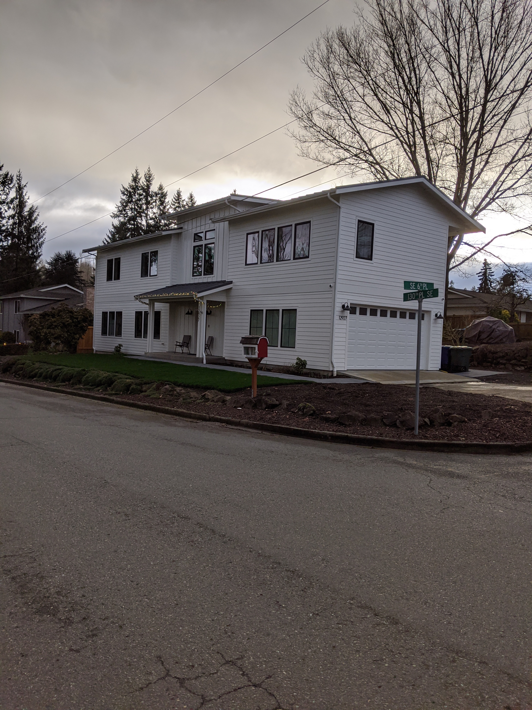
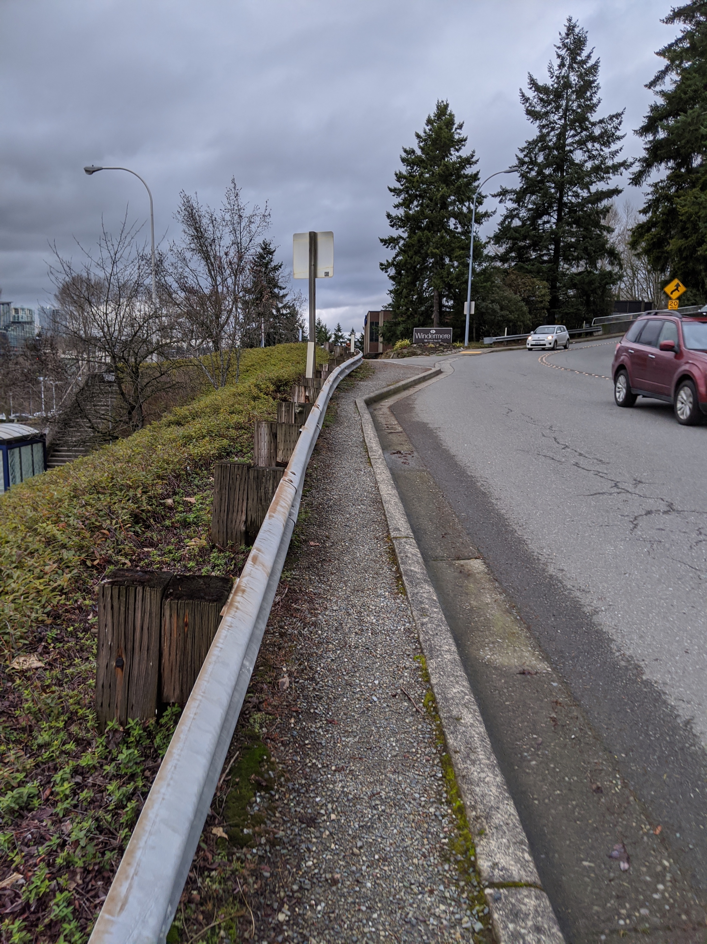
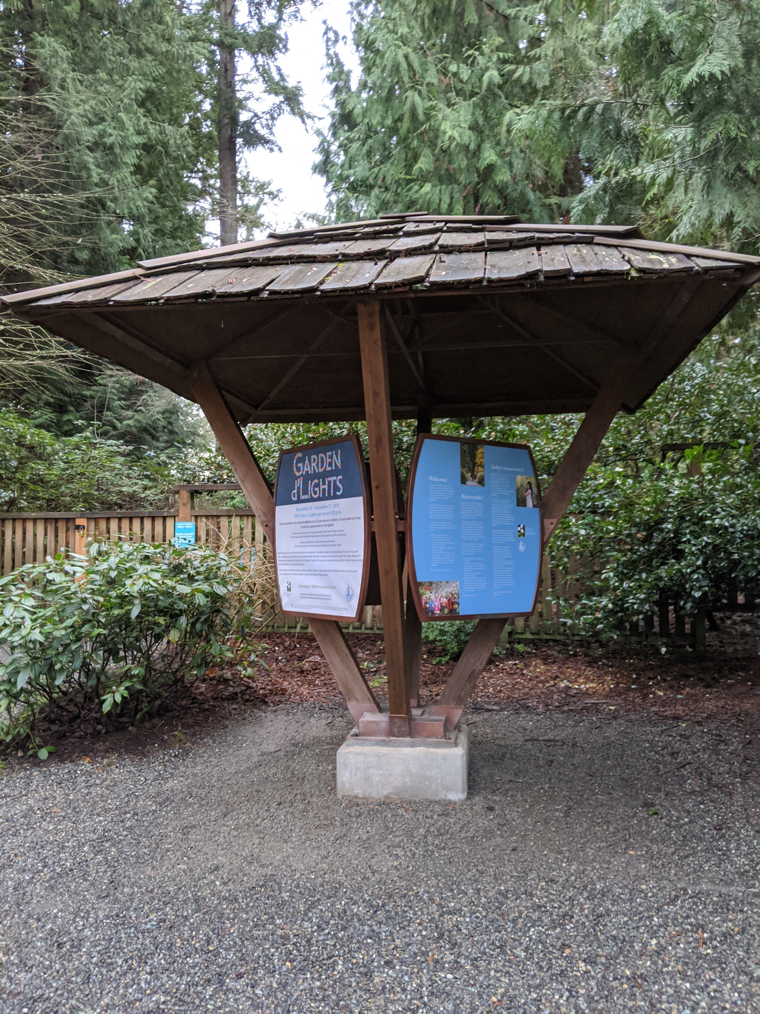
Wilburton Character
NEIGHBORHOOD ANALYSIS
Single-Family
Parks
Accessibility Issues

Slide 13
Recommendations for Wilburton
NEIGHBORHOOD ANALYSIS
Amending Bike Plan to make both directions of Lake Hills Connector Off-Path Trail
Adding Sidewalk to west side of SE 1st St.
Completing pedestrian plan for SE 7th Pl. sidewalk
Improving signage on trails within parks, directing towards trail
Delineating a better north/south bike route through neighborhood
Creating better access for low-income communities via planning, transit

Slide 14
Car-Free Day in Wilburton
NEIGHBORHOOD ANALYSIS
CONNECTIVITY
One day in the year
People must use bike, walking, etc. to commute
Based on Bogota’s día sin carro/Day without cars
Accommodations made for people who can’t walk/bike
Large enough area to encourage, exploration, shopping, other activities
El día sin carro in Bogota

Slide 15
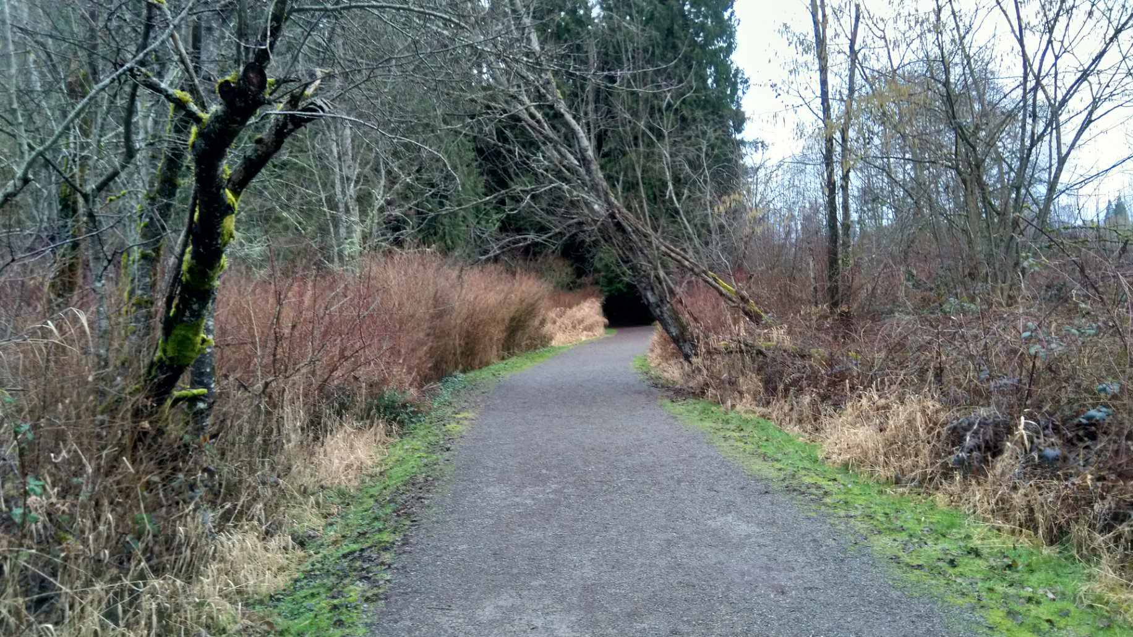
Lake Hills
NEIGHBORHOOD ANALYSIS
Notes:
Crossroads
A hub of various public and private services
Decently busy for the middle of a weekday
“Crossroads” not just a concept but also built into physical design of space
My walk went past a variety of churches, schools, and shopping villages
Would opening up the trail to these places be counter to the “meditative” goal?
Neighborhood seemed fairly car centric, but still had decent pedestrian infrastructure
From Crossroads: difficult crossing and wayfinding to enter park/trail system
Traversing the Lake to Lake was slightly confusing - could use more imposing entrance
Thin, wavy, gravel paths would make for a difficult bike trail

Slide 16
Lake Hills Character
NEIGHBORHOOD ANALYSIS
Wetlands
Architecture
History
Notes:
Architecture predominantly between 1955 and 1965. Racial demographics: More Hispanic (3.6), Black (1) and Other Race (1.8) than Bellevue, but less Asian (5.9). Still majority majority white. https://statisticalatlas.com/neighborhood/Washington/Bellevue/Lake-Hills/Race-and-Ethnicity

Slide 17
Recommendations for Lake Hills
NEIGHBORHOOD ANALYSIS
Utilize Ranger Station - make it more open to the trail
Utilize library – extend design beyond the trail
Improve entrances – make them more obvious to provide sense of being “checkpoints”
Create meditative gazebos
Notes:
Crossing @ Lake Hills Blvd

Slide 18
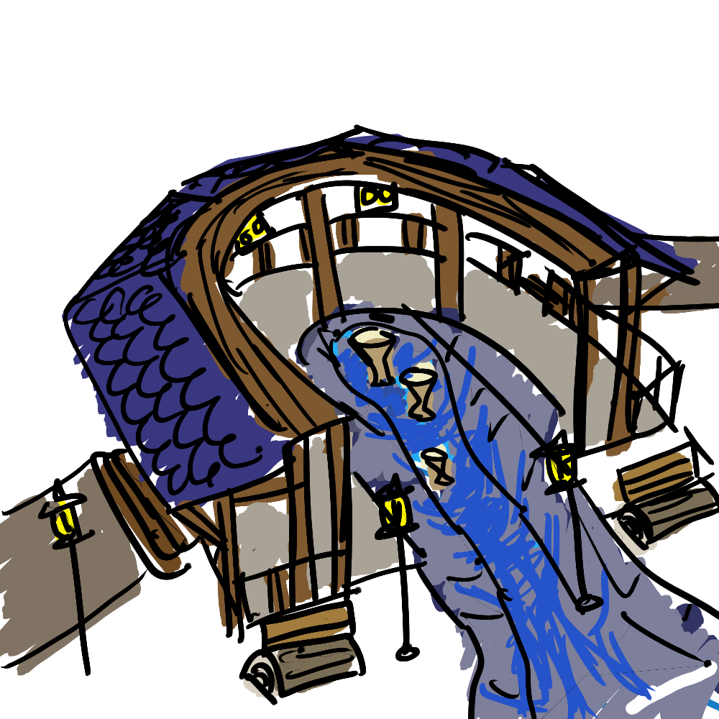
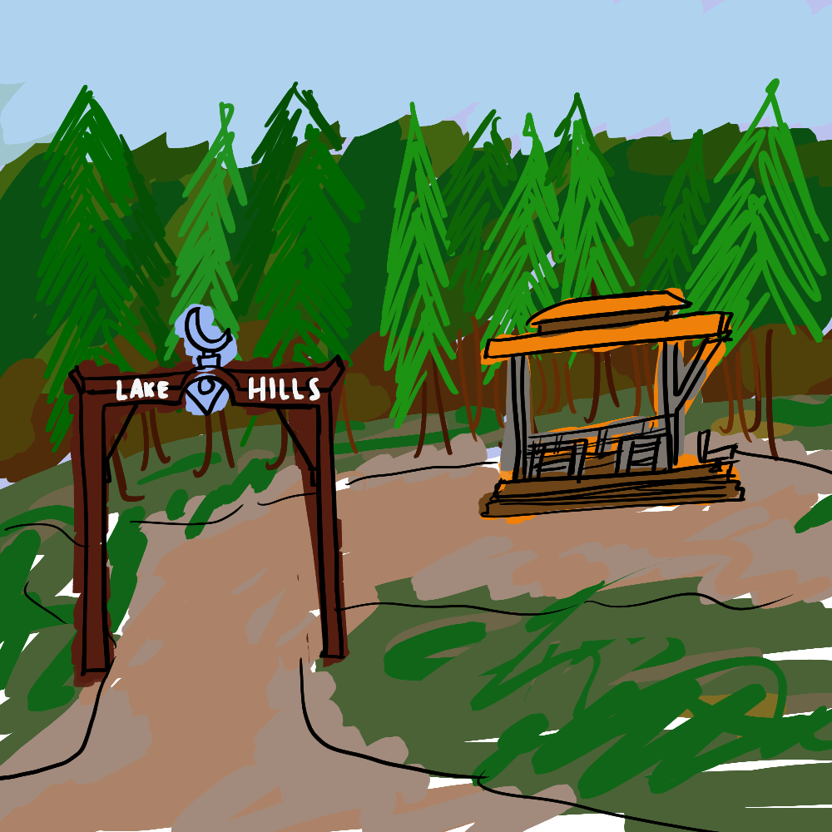
Meditative Gazebos in Lake Hills
NEIGHBORHOOD ANALYSIS
MEDITATIVE; CHECKPOINTS; ALL-DAY, ALL WEATHER ACCESS
Situated in a clearing just off the trail
Design that highlights specific areas
Addresses lack of places to linger in Lake Hills
Exhibits conflict in values

Slide 19
NEIGHBORHOOD ANALYSIS
West Lake Sammamish

Slide 20
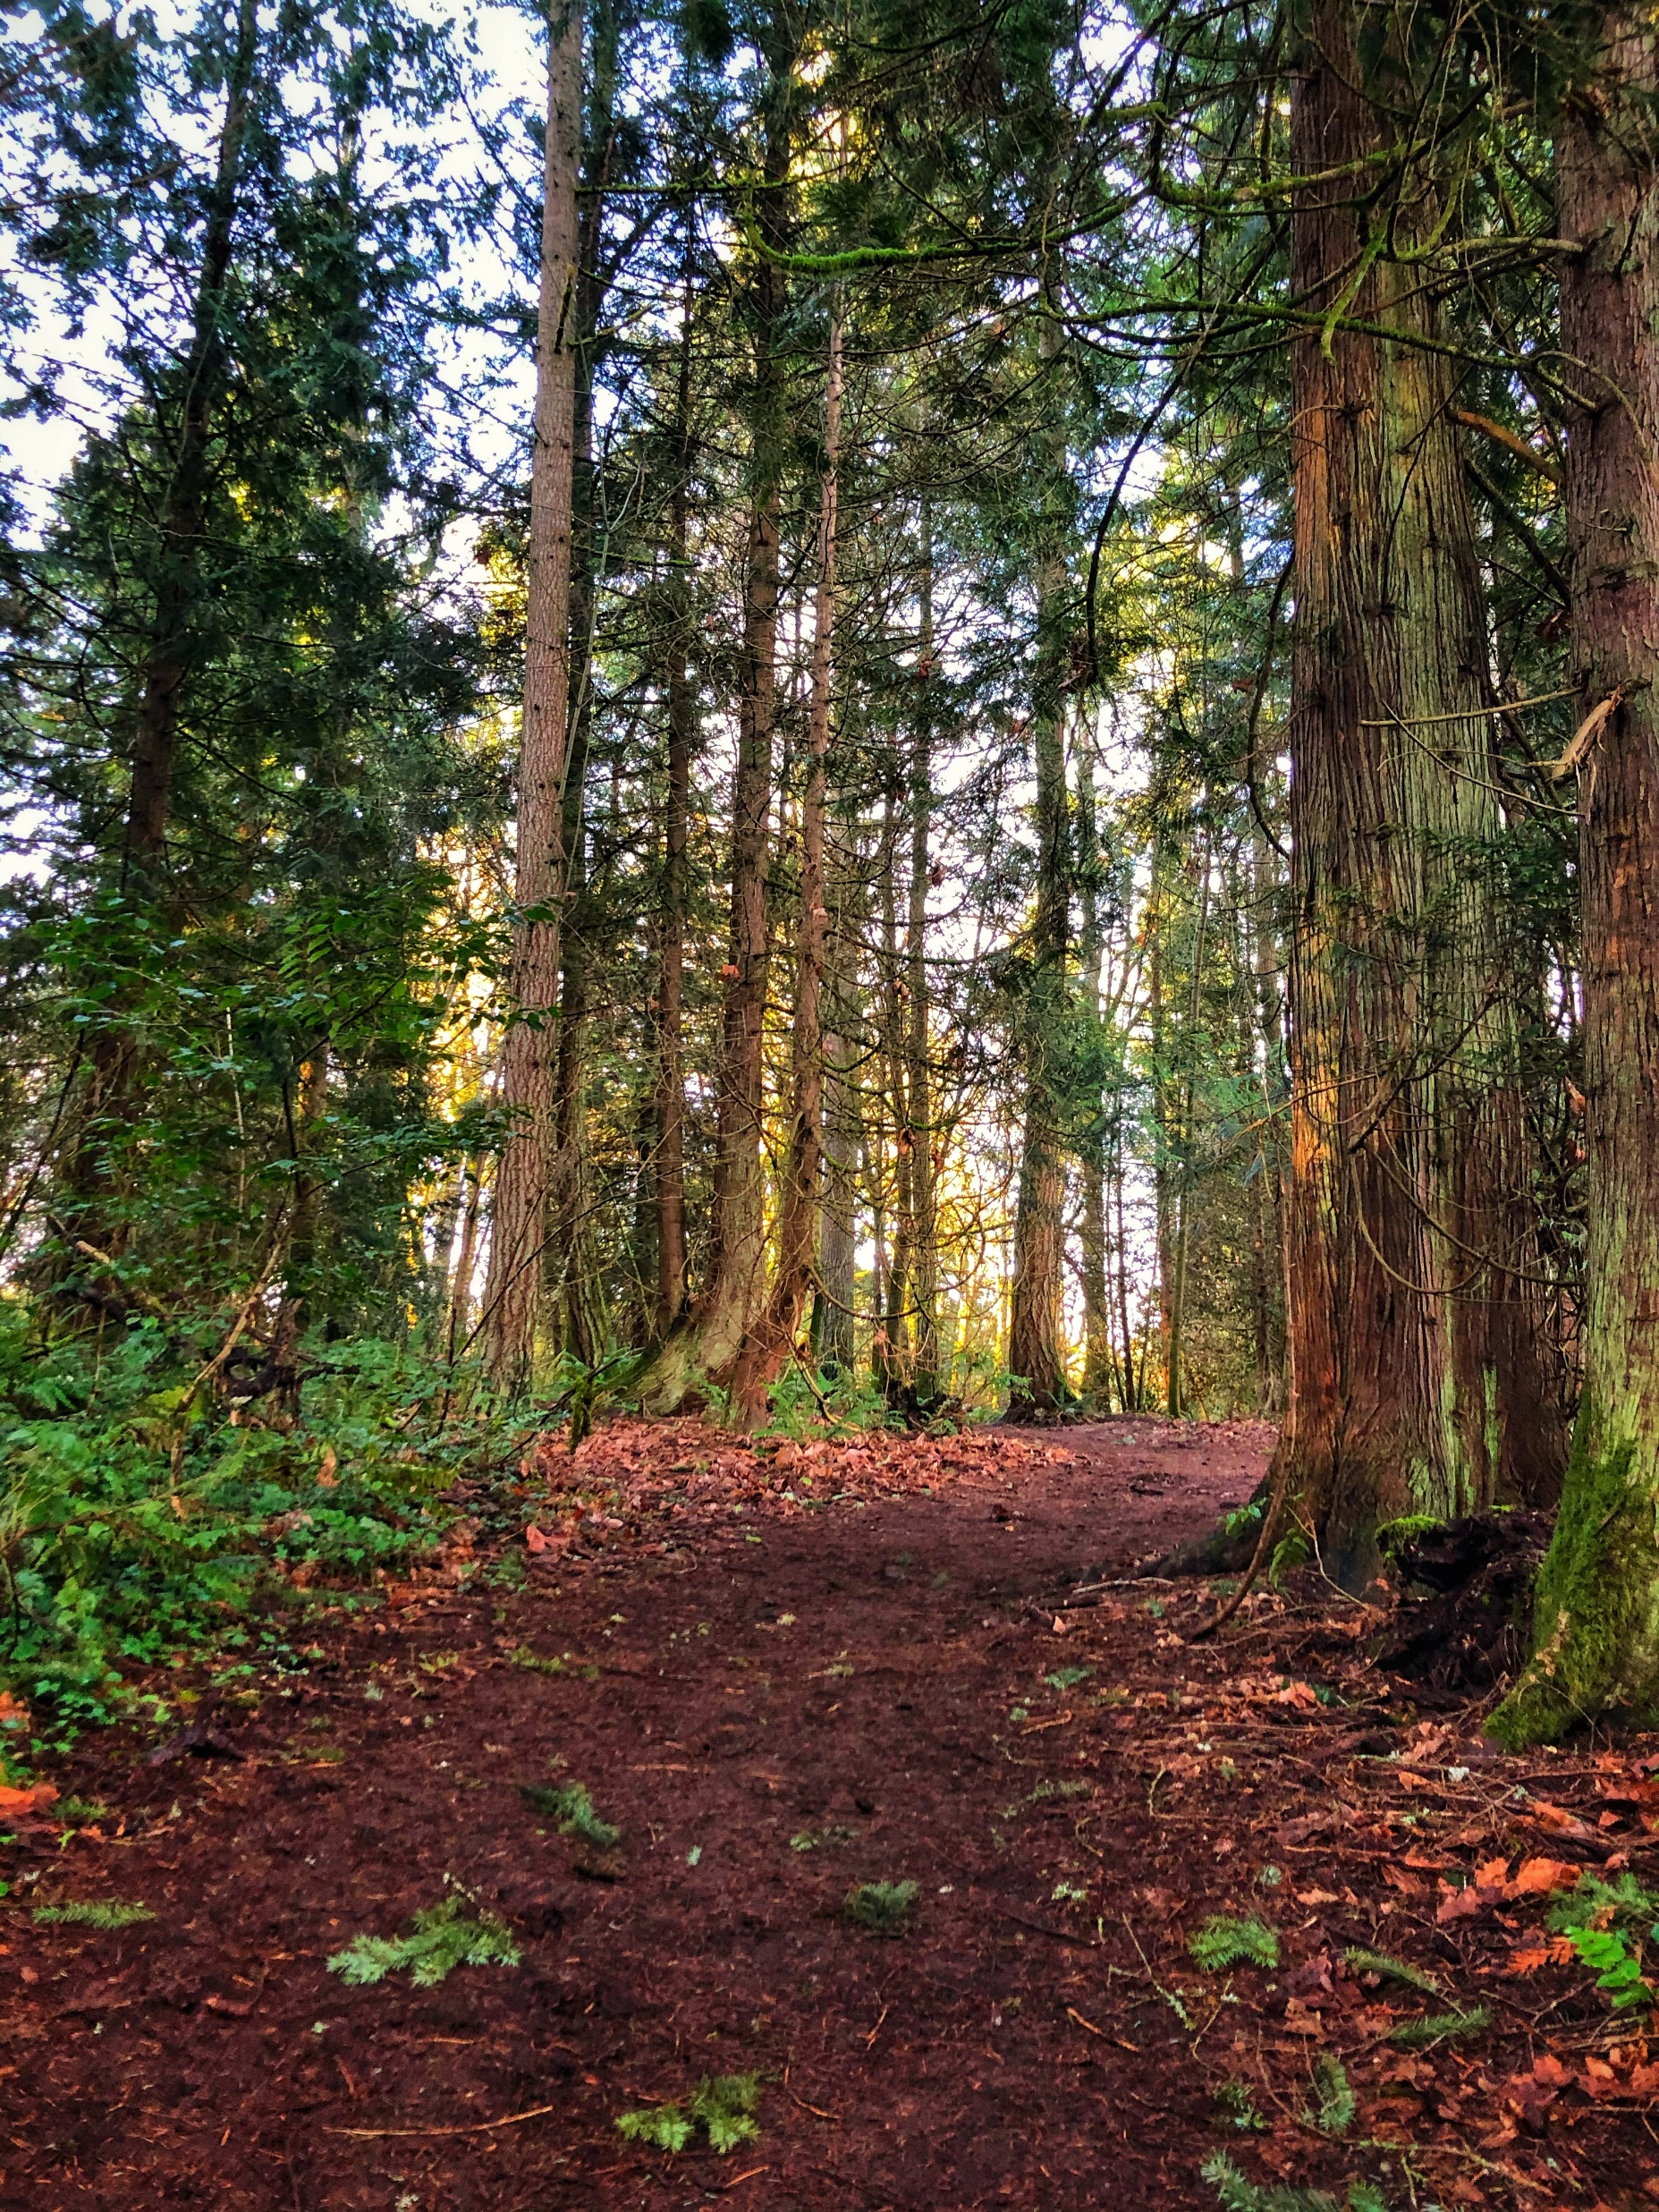
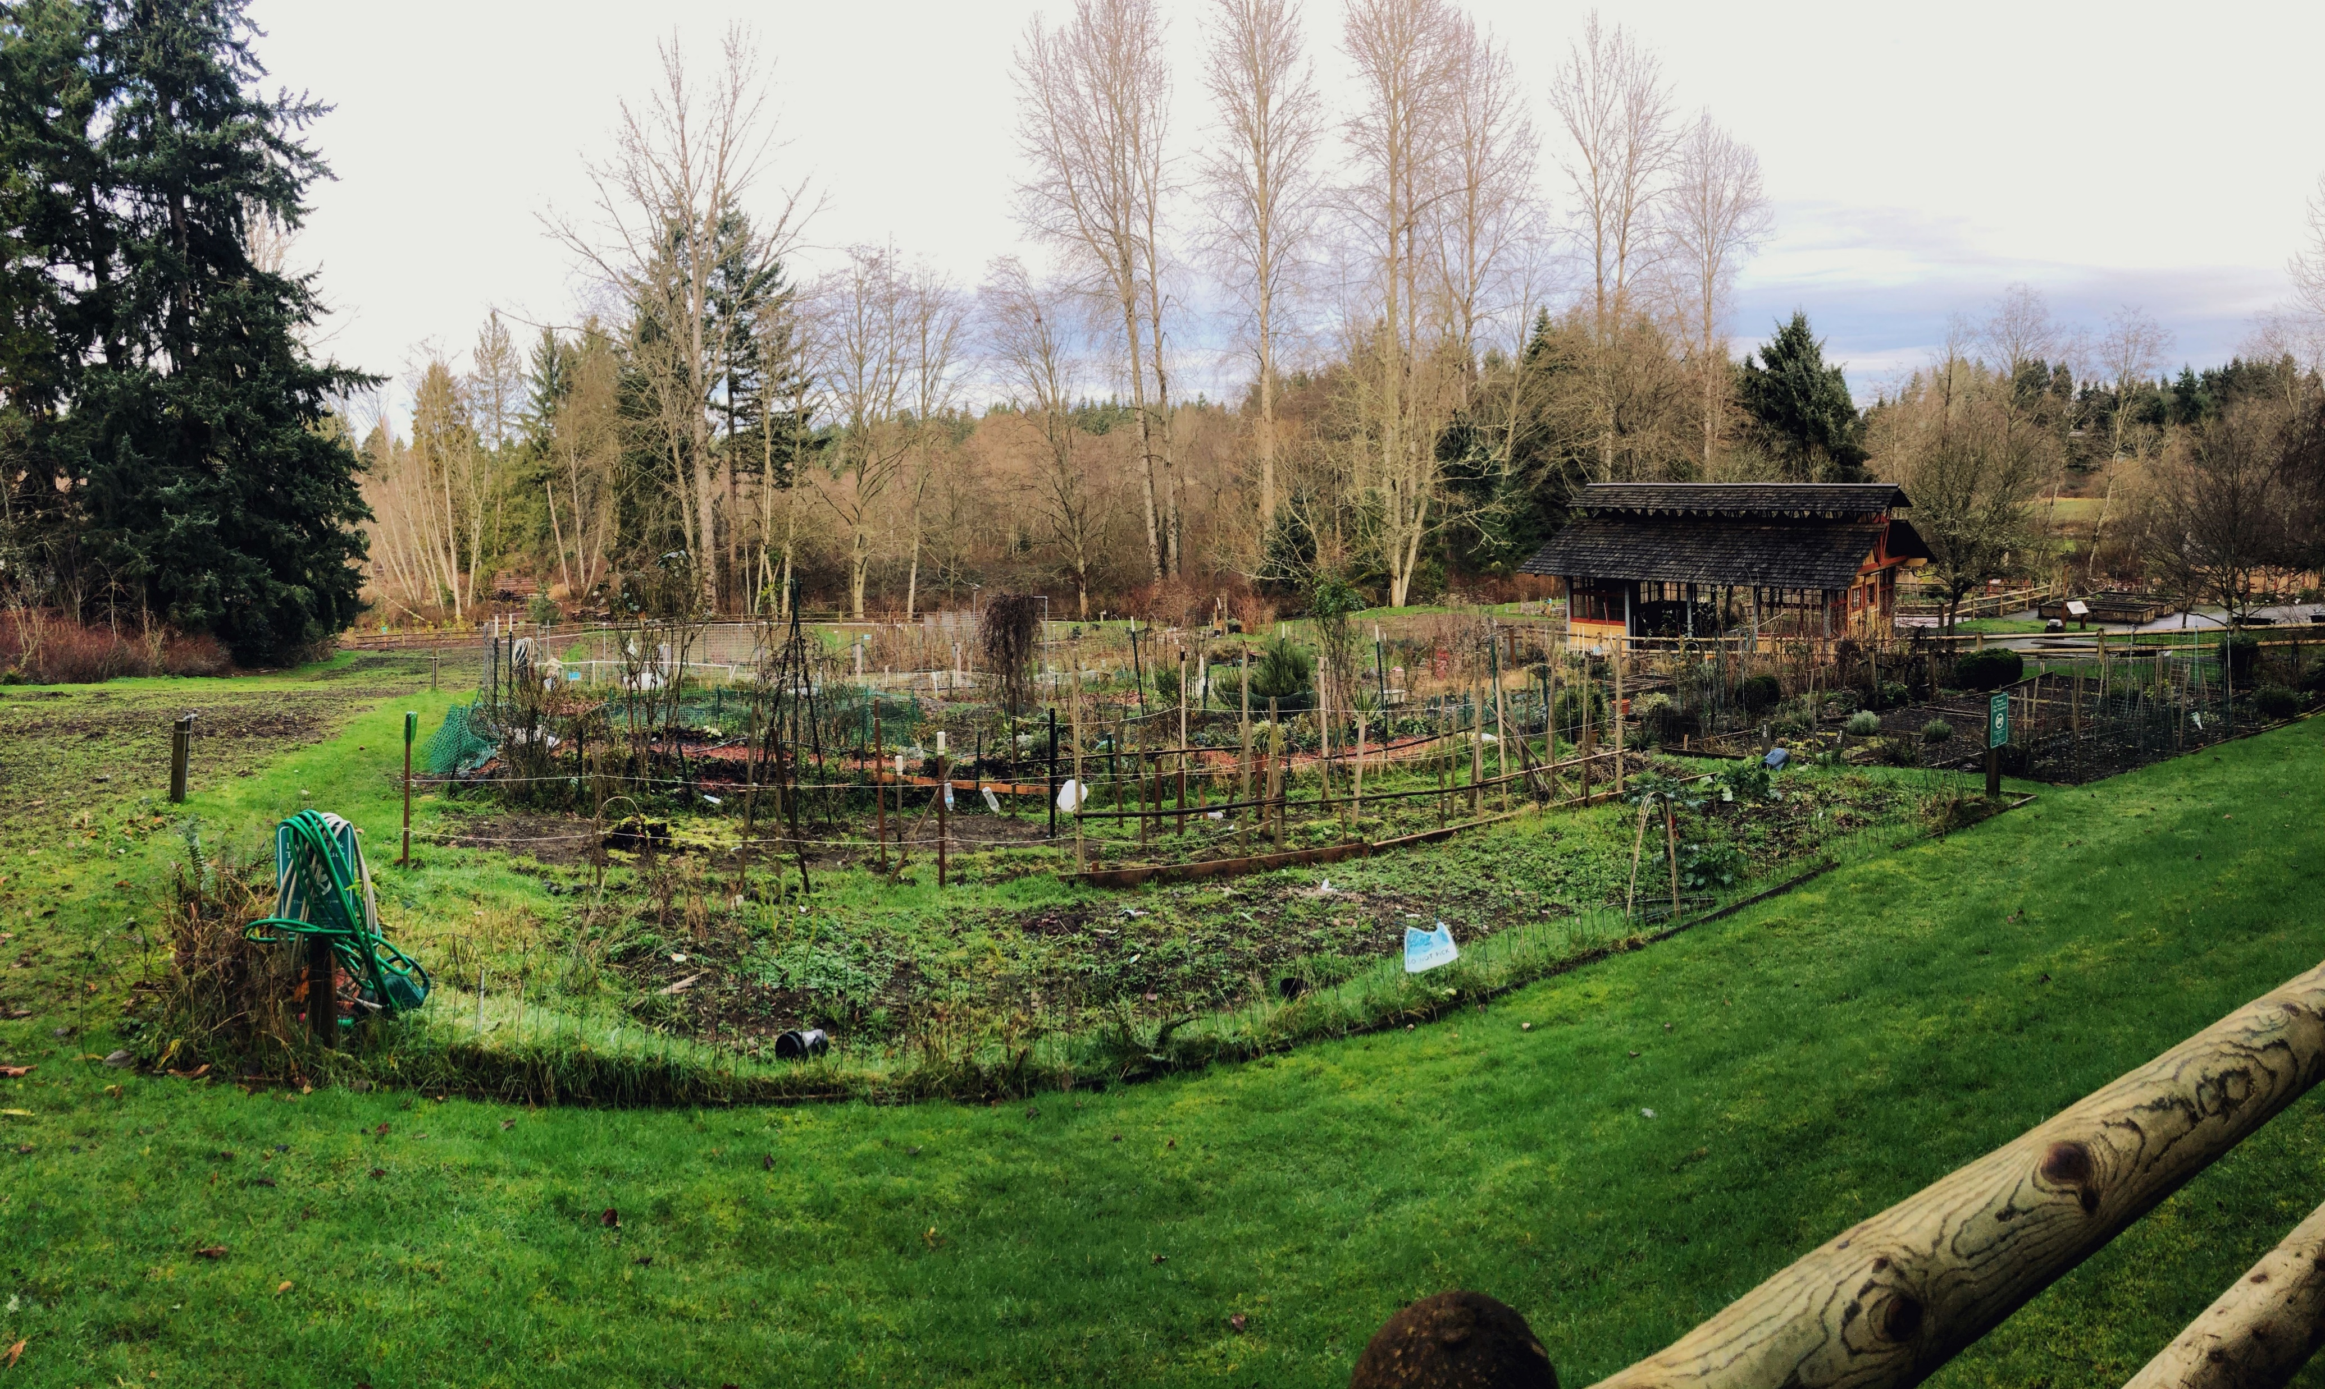
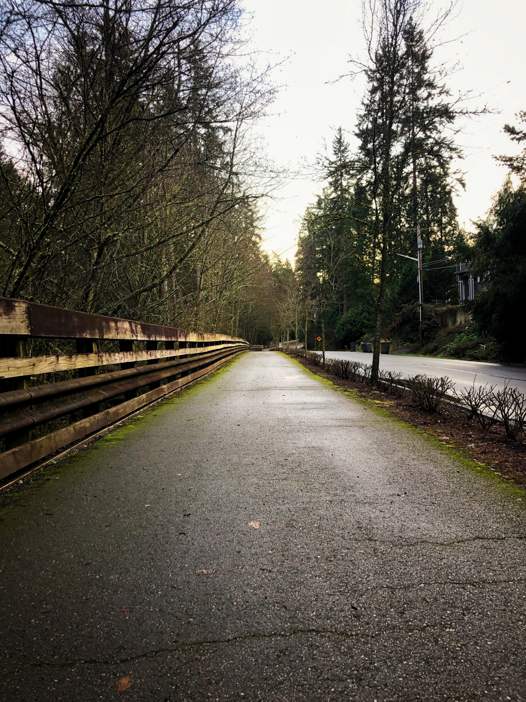
West Lake Sammamish Character
NEIGHBORHOOD ANALYSIS
Parks
Community
Connectivity

Slide 21
Recommendations for West Lake Sammamish
NEIGHBORHOOD ANALYSIS
Create an engaging atmosphere for pedestrians
Use of art or signage to address the community
Small details such as fencing
Bike racks

Slide 22
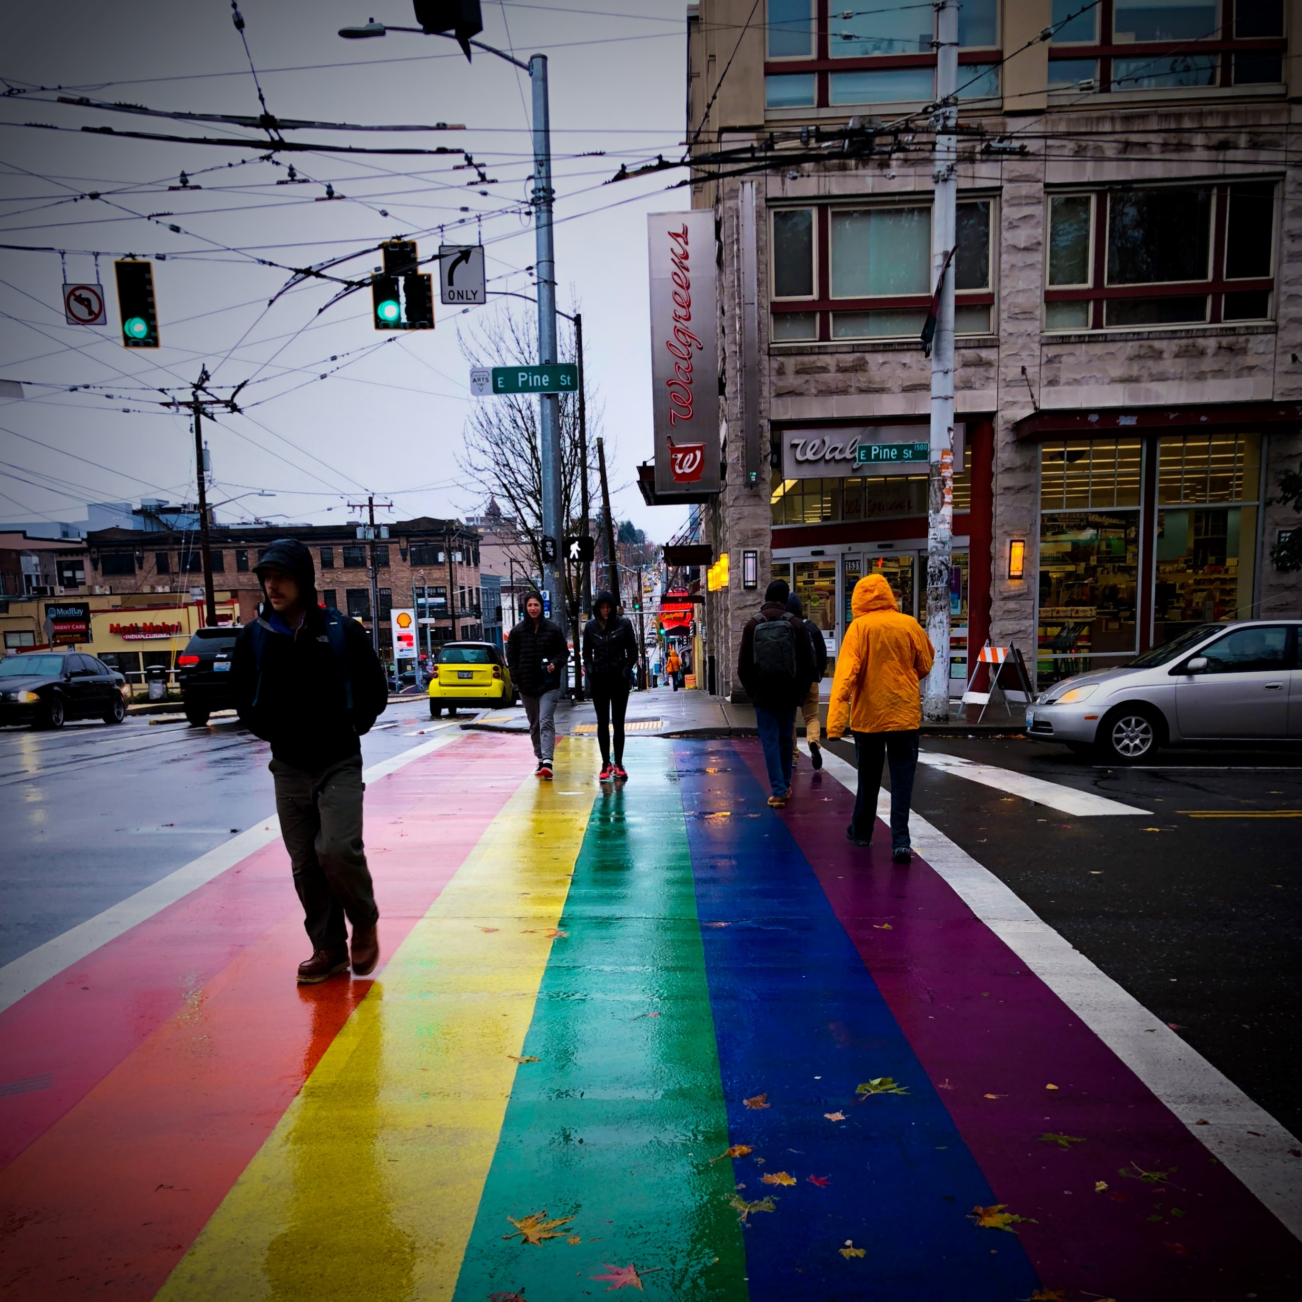
Creative Signage in West Lake Sammamish
NEIGHBORHOOD ANALYSIS
Coordinated Stories Through Art
Portions of the trail could include more engaging elements to enhance its identity
Potential design elements could address:
Minority groups
Natural design elements (based on psychological research)
Allow for increased appreciation of the trail and the surrounding environment
Capitol Hill’s LGBTQ+ Creative Crosswalk

Slide 23
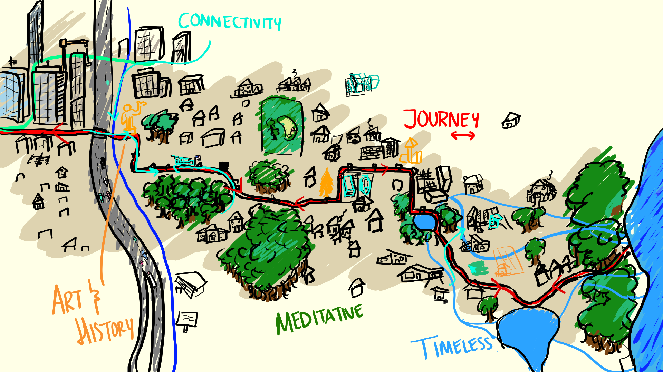
Summary
Notes:
To ensure the L2L is a place – must be guided and respond to people – these five values are part of this response
Relevant to people who live there
Not overlooking communities along trail – uplifting them instead
Justifies for businesses – open to more communities to more parts of the city
Provide outlets for people – creative, meditative – to promote interaction with nature, self, communities

Slide 24
Questions?
Group Members
David Blum (Instructor) - blumedw@uw.edu
Matthew Bauman (CEP, 3rd Year) - mb.bcic@gmail.com
Evan Eggerud (Poli. Sci / Communications, 3rd Year) – sn340745@uw.edu
Cameron Miller (Geography, 4th Year) – sidmil@uw.edu
Sophia Smith (ESRM, 3rd Year) – ssmith99@uw.edu

Slide 25
Image Sources
Lake Hills
Water Basin from Bellevue Utilities
Lake Hills home from Google Street View

